Slide 1
Emergence of Intelligent Machines:
Challenges and Opportunities
CS6700:
The Emergence of Non-Human Intelligence
Prof. Carla Gomes
Prof. Bart Selman
Cornell University

Slide 2
Non-Human Intelligence
  AI focus: Human intelligence because that’s the intelligence we know…
  Cognition: Perception, learning, reasoning, planning, and knowledge.
  Deep learning is changing what we thought we could do, at least in perception and learning (with enough data).

Slide 3
Artificial Intelligence
  Separate development --- “non-human”: Reasoning and planning. Similar qualitative and quantitative advances but “under the radar.”
    Part of the world of software verification, program synthesis, and automating science and mathematical discovery.
  Developments proceed without attempts to mimic human intelligence or even human intelligence capabilities.
  Truly machine-focused (digital): e.g., “verify this software procedure” or “synthesize procedure” --- can use billions of inference steps --- or “synthesize an optimal plan with 1,000 steps.” (Near-optimal: 10,000+ steps.)

Slide 4
Example
  Consider a sequence of 1s and -1s, e.g.:
  -1, 1, 1, -1, 1, 1, -1, 1, -1 …
  1 2 3 4 5 6 7 8 9 …
  2 4 6 8 …
  3 6 9 …
  and look at the sum of sequences and subsequences:
  -1 + 1 = 0
  -1 + 1 + 1 = 1
  -1 + 1 + 1 + -1 = 0
  -1 + 1 + 1 + -1 + 1 = 1
  -1 + 1 + 1 + -1 + 1 + 1 = 2
  -1 + 1 + 1 + -1 + 1 + 1 + -1 = 1
  -1 + 1 + 1 + -1 + 1 + 1 + -1 + 1 = 2
  -1 + 1 + 1 + -1 + 1 + 1 + -1 + 1 + - 1 = 1
  and “skip by 1”
  1 + -1 = 0
  1 + -1 + 1 = 1
  1 + -1 + 1 + 1 = 2
  and “skip by 2”
  1 + 1 = 2
  1 + 1 + -1 = 1
etc.
etc.
etc.
We now know (2015): there exists a sequence of 1160 +1s and -1s such that sums of all subsequences never < -2 or > +2.

Slide 5

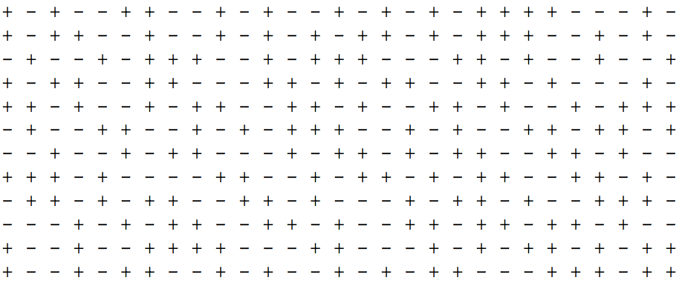
1160
elements
all sub-sums
stay between
-2 and +2
40 x 29 pattern

Slide 6
So, we now know (2015): there exists a sequence of 1160 +1s and -1s such that sums of all subsequences never < -2 or > +2.
Result was obtained with a general reasoning program
(a Boolean Satisfiability or SAT solver). Surprisingly, the approach
far outperformed specialized search methods written for the
problem, including ones based on other known types of
sequences. (A PolyMath project started in January 2010.)

Slide 7
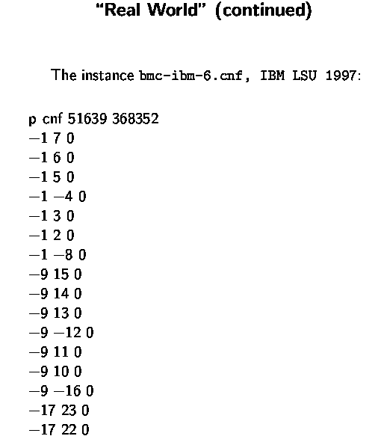
Aside: A Taste of Problem Size
Consider a real world Boolean Satisfiability (SAT) problem,
from software & hardware verification.
“1” for variable x_1, “2” for x_2, etc.
x_1, x_2, x_3, … our Boolean variables
(set to True or False)
Each line gives a brief logical statement
(“0” marks end of line)
((not x_1) or x_7)
((not x_1) or x_6)
etc.
Question: Can we satisfy all statements?
Set x_1 to False ??
SAT problem lies at the core of computer science
Prototypical NP-complete problem (from P vs. NP)

Slide 8
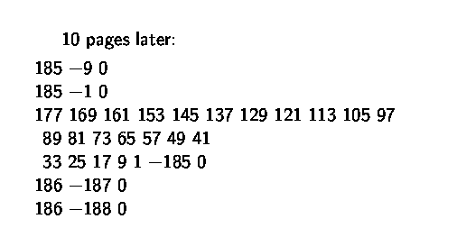
10 pages later:
…
I.e., (x_177 or x_169 or x_161 or x_153 …
x_33 or x_25 or x_17 or x_9 or x_1 or (not x_185))
clauses / constraints are getting more interesting…
Note x_1 …

Slide 9
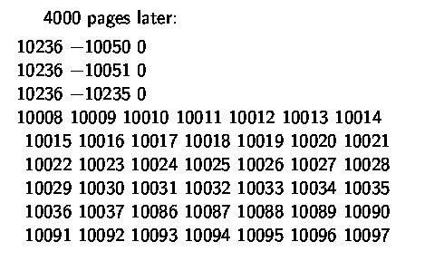
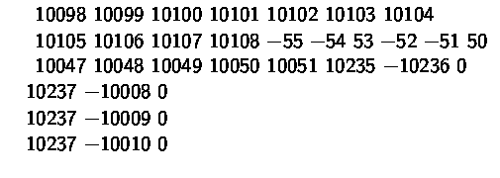
4000 pages later:
…

Slide 10
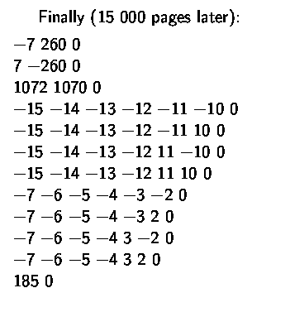

Finally, 15,000 pages later:
Search space of truth assignments:
Current reasoning engines can solve this instance in
a few seconds! (no satisfying assignment exists + proof)

Slide 11
Back to sequences of +1/-1s
Encoding has variables for the sequence X_1, X_2, …, X_N
(we interpret True for +1 and False for -1)
but also e.g.
Proposition: “sum_of_first_2_terms_of_step_by_2_subseq_=_2”
(for any given setting of X_1 … X_N this is either True or False)
and statements of the form:
IF (( sum_of_first_2_terms_of_step_by_2_subseq_=_2 == True)
AND (X_8 == False))
THEN
(sum_of_first_3_terms_of_step_by_2_subseq_=_1 == True)
Encoding: 37,418 variables and 161,460 clauses / constraints.
Sequence found in about 1 hour (MacBook Air).
Perhaps SAT solver was “lucky” in finding the sequence?

Slide 12
But, remarkably, each sequence of 1161 or longer leads to a +3 (or -3) somewhere. (Erdos discrepancy conjecture)
Encoding: 37,462 variables and 161,644 clauses / constraints.
Proof of non-existence of discrepancy 2 sequence found in about 10 hour (MacBook Air).
Proof: 13 gigabytes and independently verified (50 line proof checking program). Proof is around a billion small inference steps.
  Machine understands and can verify result easily (milliseconds); Humans: probably never. Still, we can be certain of the result because of the verifier.

Slide 13
Observations
Result different from earlier “computer math” results, such as the proof of the 4 color theorem, because here we don’t need to trust the theorem prover. Final proof (“certificate”) can be checked easily by anyone.
It’s not a brute force search. Earlier SAT solvers cannot find the proof. Specialized programs cannot find the proof.
  Brute force proof is of order 2^1161 = 3.13 x 10^349. Current solver finds complete proof with “only” around 1.2 x 10^10 steps. Clever learning and reasoning enables a factor 10^339 reduction in proof size.
In part inspired by discrepancy 2 result, Terence Tao proved just a few months ago the general Erdos conjecture (for any discrepancy). Deep and subtle math.
But, does not fully supersedes the 1161 result for the discrepancy 2. Future math may build further on these types of computational results. (I.e. true, verifiable facts but not human accessible.)

Slide 14
Other examples
  AlphaGo / AlphaGoZero:
    Core engine
    Monte Carlo Tree Search (UCT, 2006) + Deep Learning
    Final boost: deep learning and reinforcement learning.
      Search part and insights may remain beyond human understanding. Update: Google’s DeepMind team is studying this issue.
  Planning: We can synthesize optimal plan sequences of 1000+ steps.
  Changes the notion of a “program”
  A planning-enabled robot will synthesize its plans on-the-fly given its current abilities. Quite different from current pre-programmed industrial robots.

Slide 15
Comp. Compl. / Intelligence Hierarchy
EXP-complete:
games like Go, …
EXP
Hard
PSPACE-complete:
QBF, planning, chess (bounded), …
PSPACE
MACHINES
#P-complete/hard:
#SAT, sampling,
probabilistic inference, …
P^#P
PH
NP-complete:
SAT, propositional
reasoning, scheduling,
graph coloring, puzzles, …
NP
P-complete:
circuit-value, …
HUMANS
P
In P:
sorting, shortest path, …
What are the consequences for human understanding
of machine intelligence?
Easy

